Slide 1
R: Exploratory Data Analysis – Using Dataset Global Superstore

Slide 2



About me
Kurnia Anwar Ra’if
A Highly motivated in Earth Science who is currently into Software – Engineer and Data Science in Geothermal Consultant.
Software Engineer – PT. Ailima Geothermal Consultant ( NOW )
Data Analyst – Rock Laboratory Physics ( Aug 2019 – Jan 2020 )
Intern Data Analyst – Nuclear Lab. Osaka Univ, Japan ( Nov 2019 )

Slide 3
EDA using ggplot
Visualization
EDA
Data Type Category
Data Type Continuous
Outline & Framework
Exploratory Data Analysis
Plot
Plot
Merge data information type category and data information + Continuous Data
Get Insights

Slide 4
Visualization

Slide 5
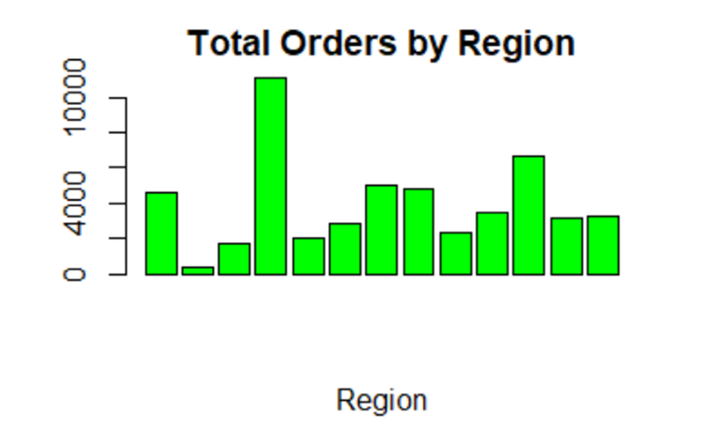
Visualisation : Orders by Region
EMA
West
East
center
North
South
Southeast Asia
Africa
Oceania
Canada
Caribbean
Central Asia
North Asia

Slide 6
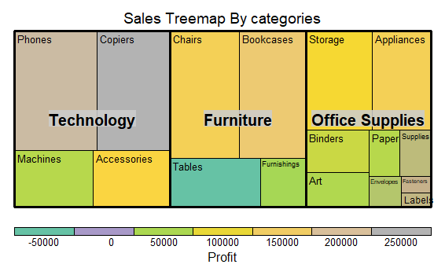
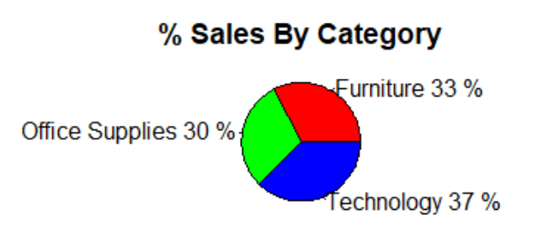
Visualisation : Treemap and Sales by Category

Slide 7
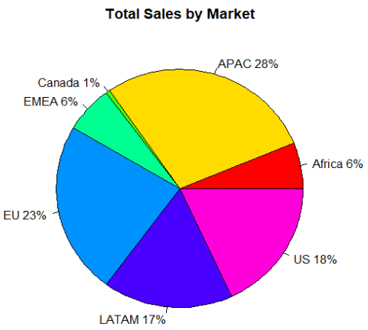
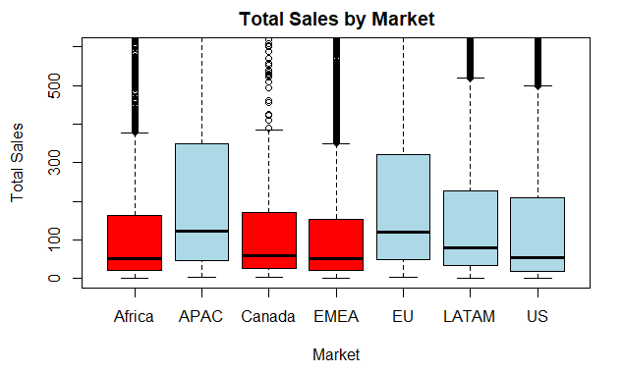
Visualisation : Total sales by market

Slide 8
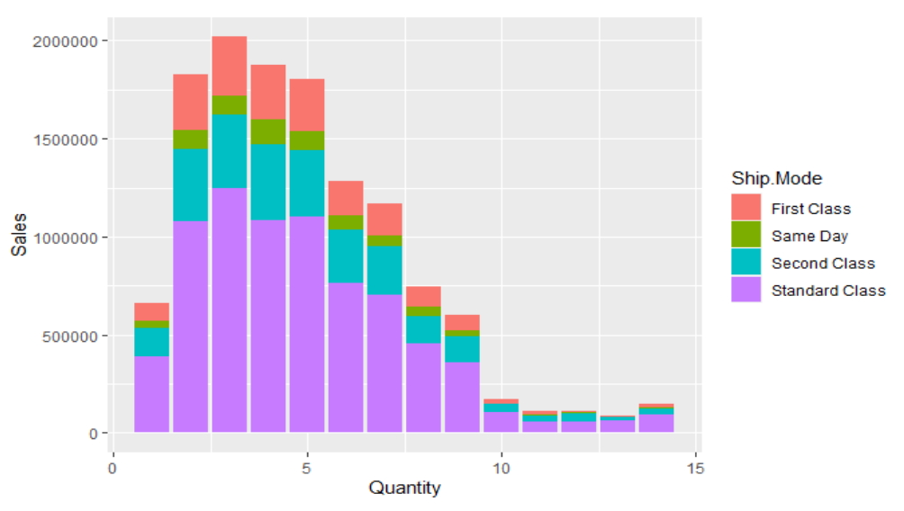
Visualisation : Sales Vs Quantity

Slide 9
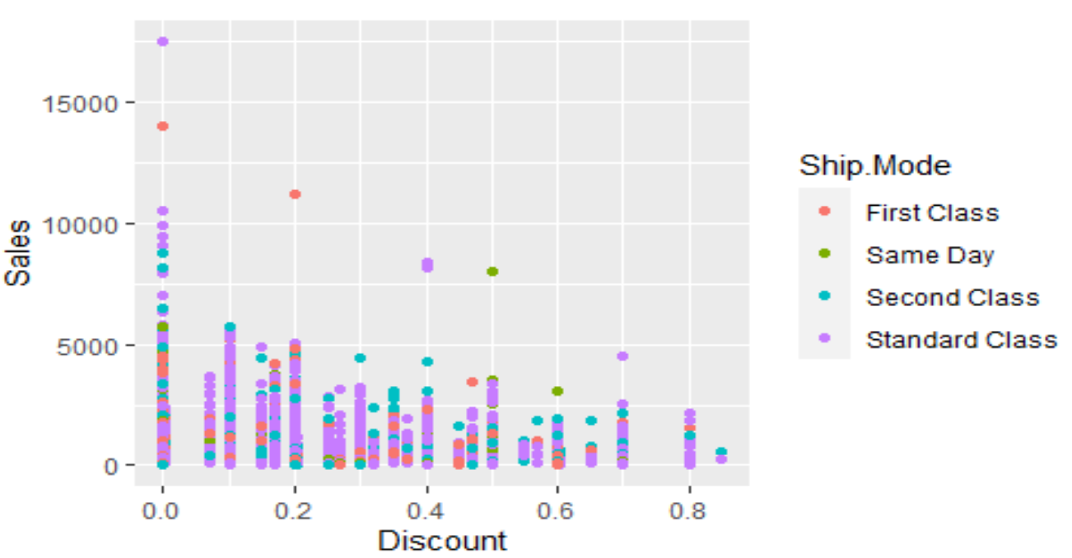
Visualisation : Sales vs Discount

Slide 10
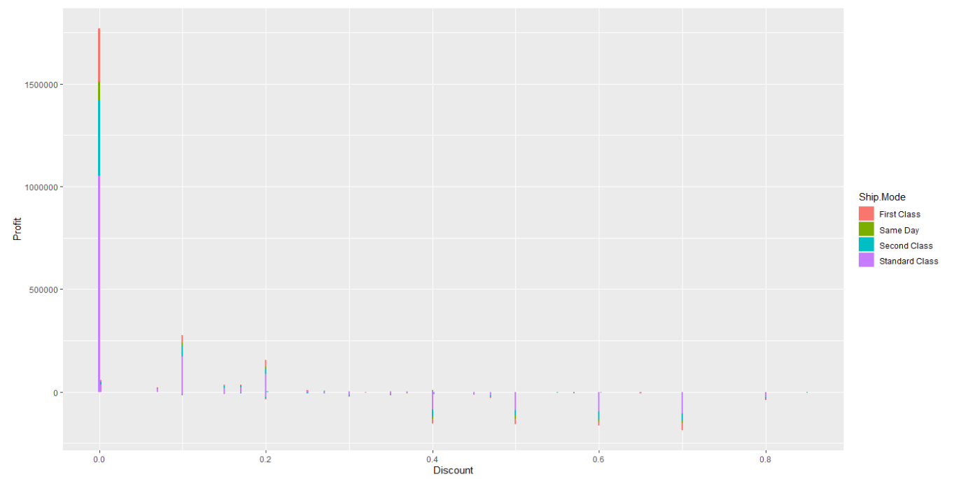
Visualisation : Profit vs Discount

Slide 11
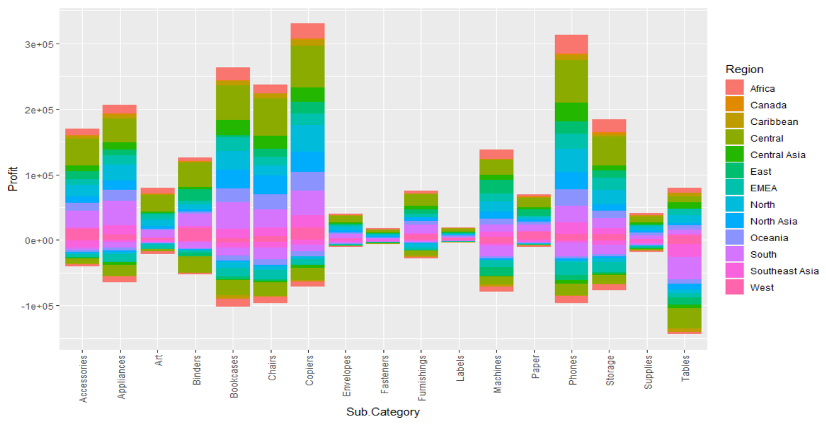
Profit vs Region vs Sub-Category

Slide 12
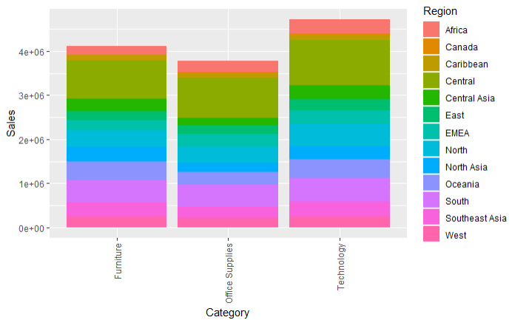
Sales vs Category vs Region

Slide 13
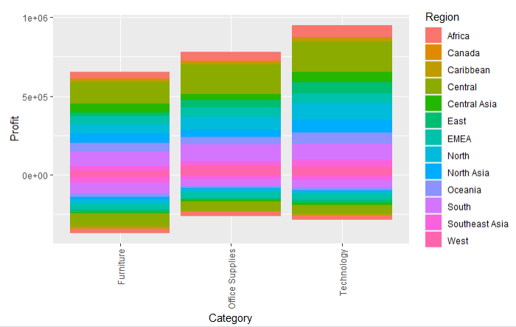
Profit vs Category vs Region

Slide 14
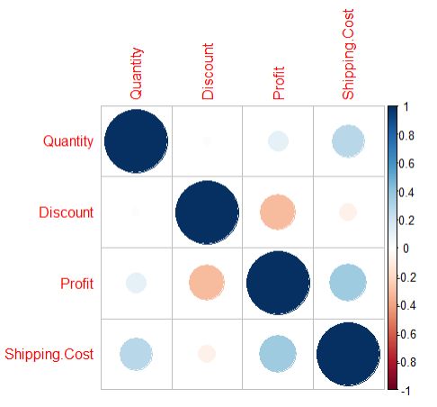
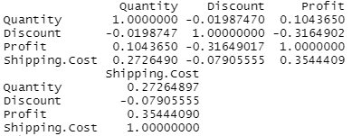
correlation matrix between sales, discount, quantity, profit

Slide 15
Insights and Advice

Slide 16
Thank you ☺

Slide 17
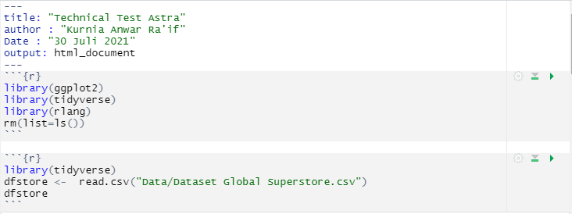
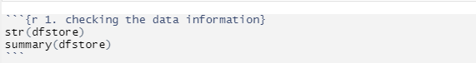
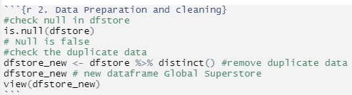
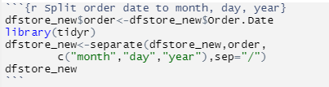
Attachment
1
2
3. Data Cleaning

Slide 18
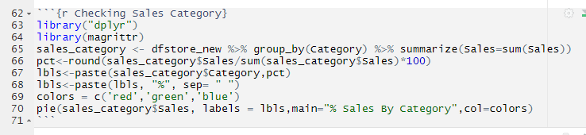
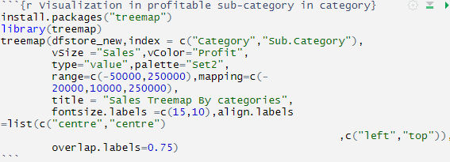
Code : Orders by Region
Code : Sales by Category and tree map

Slide 19
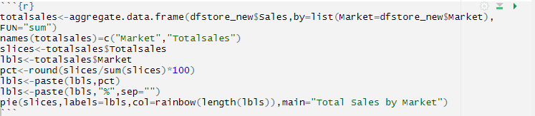
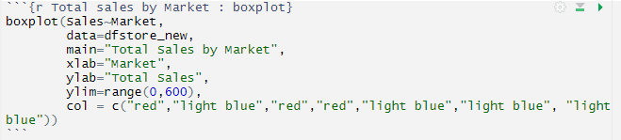
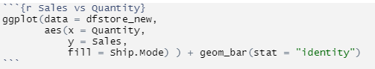
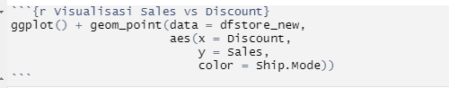
Code : Total sales by market and boxplot
Code : Sales vs Quantity
Code : Sales vs Discount

Slide 20
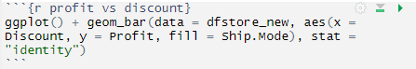
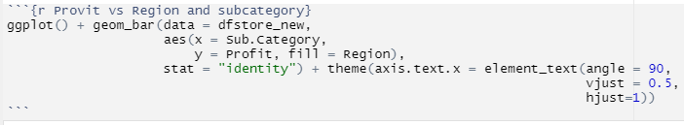
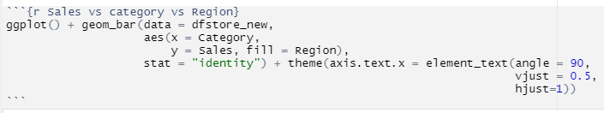
Code : Profit vs Discount
Code : Profit vs Region vs Sub-Category
Code : Sales vs Category vs Region

Slide 21
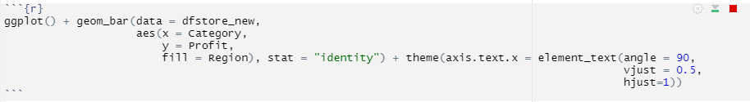
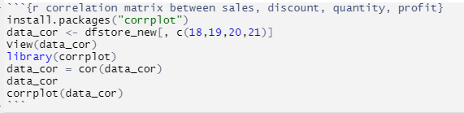
Code : Profit vs Category vs Region
Code : Cor-matrix sales, discount, quantity, profit

